Slide 1
FINAIRA
Privacy Gateway for
Arabic-English Financial Documents
Graduation Project Sponsorship Interview
Faculty of Engineering, Ain Shams University
Computer and AI Engineering | Expected graduation 2027
September 2026
Notes:
Opening, about 20 seconds. Introduce the project as an investigation into reliable privacy protection for Arabic-English financial documents before cloud LLM use. Avoid claiming that the gateway pattern itself is new.

Slide 2
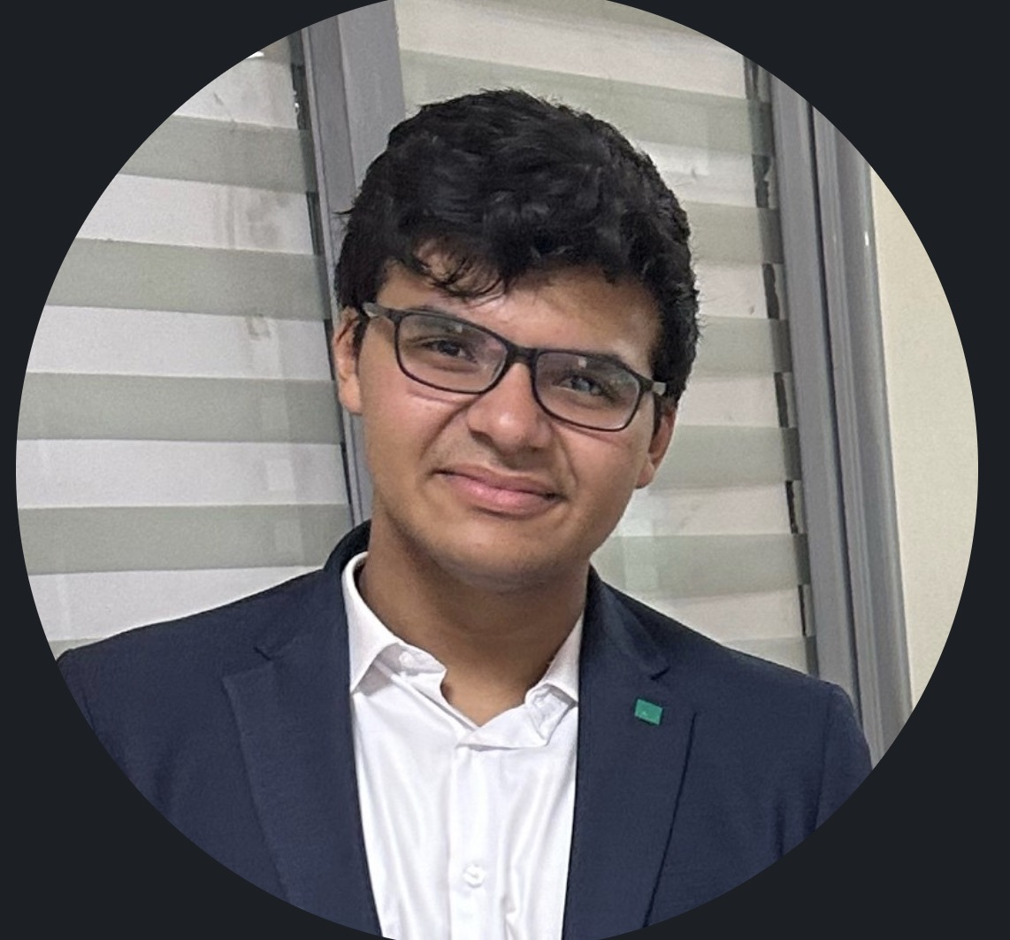
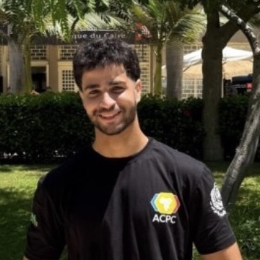
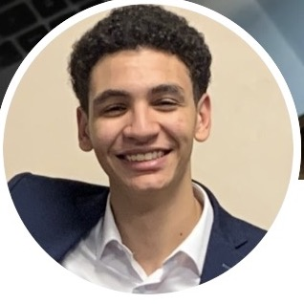
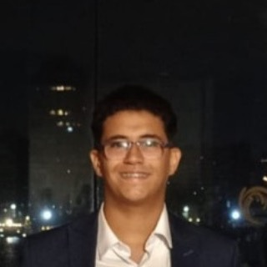
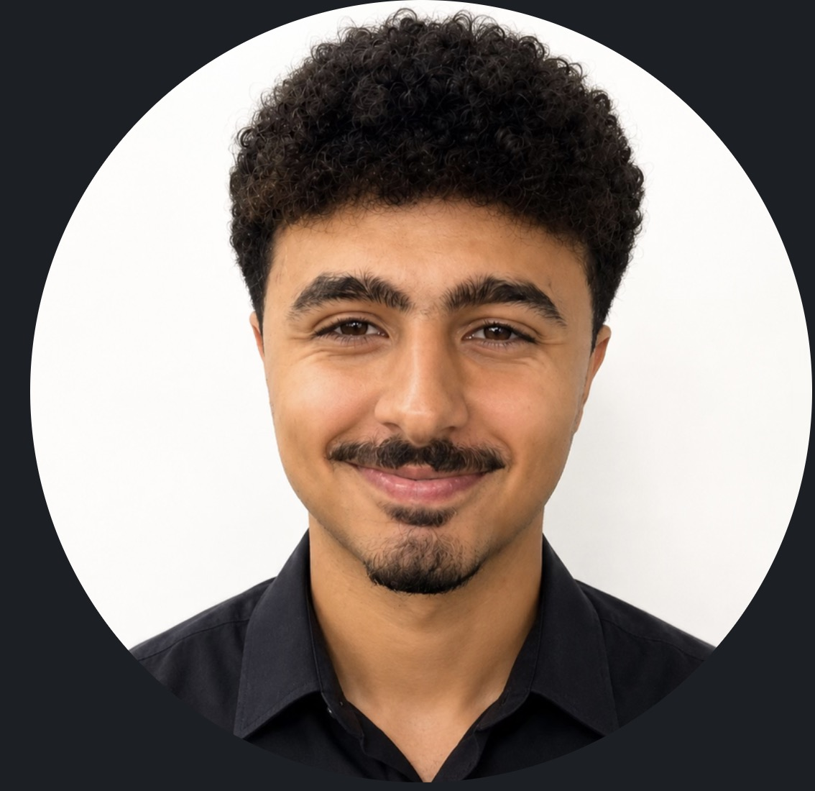
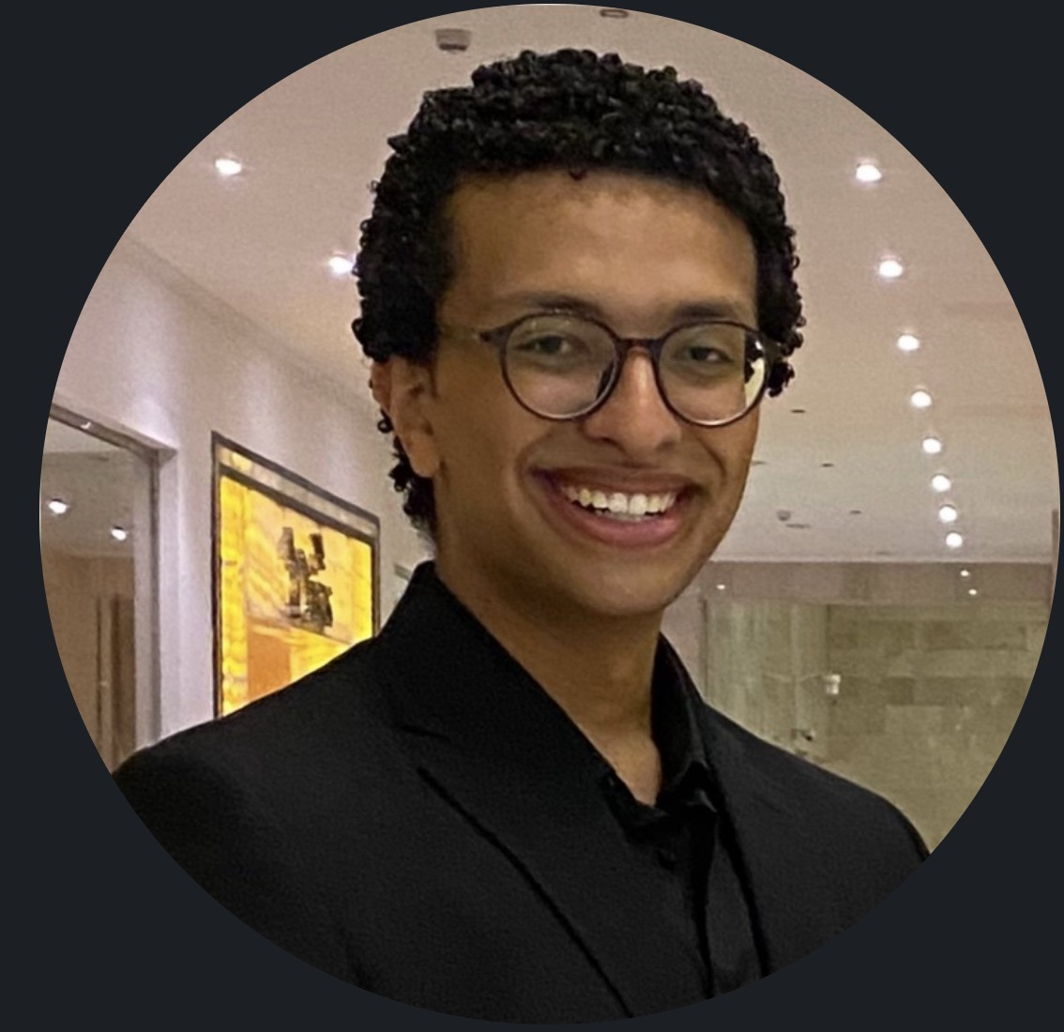
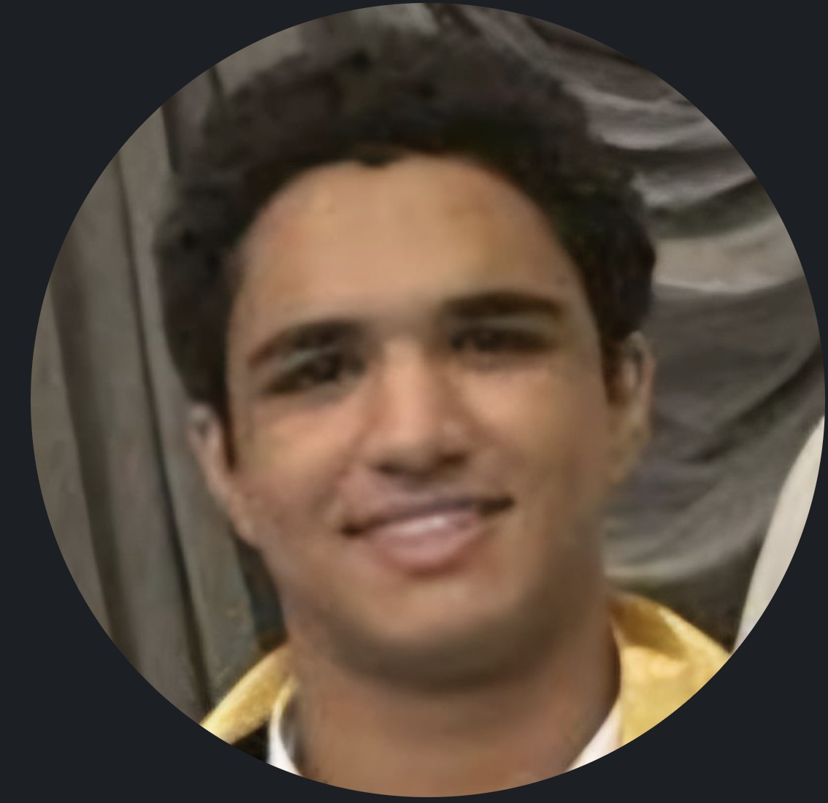
PART 1
Our team
Faculty of Engineering, Ain Shams University
Computer and AI Engineering | Expected graduation 2027
Belal Anas
Omar Tamer
Amir Tamer
Mohamed Wael
Adham Walid
Basem Walid
Moaz Ahmed
Finaira sponsorship interview
02
Notes:
About 45 seconds. Replace each [Name] and [Primary strength]. Mention the team's shared engineering background, then briefly explain role ownership and the decision process. Source: user-provided team photos and university details.

Slide 3












PART 1
Experience and selected work
INTERNSHIPS
RELEVANT COURSEWORK
Al Ahly Momken
Cisco
Object-oriented programming
Databases
El Sweedy Electronics
Ejada
Networks
Natural language processing
Cellula
Klickit
Data structures
Machine learning
VOIS
Xyris Digital Solutions
Artificial intelligence
Web development
Agile Software Development
e&
Siemens
Distributed computing
Cyshield
Pixelogic Media
IZAM
COMPETITION
ECPC programming competition
PROJECTS
Baseet.ai
User behaviour telemetry analysis framework
Distributed RAG system
Reddit clone
Quote-Grounded Language Model Context for Football Starting Lineup Prediction: Measuring Rather Than Assuming Contamination (research paper)
MNIST classification using different ML models built from scratch
ReelRadar
Finaira sponsorship interview
03
Notes:
About 45 seconds. Team-wide experience supplied by the students. These internships and projects belong to different team members. Add ownership and exact internship roles orally if the panel asks; do not imply every member worked at every company. ECPC participation is also team-provided.

Slide 4
PART 2
Why we chose AI in fintech
WHY THIS DOMAIN
WHAT WE WANT TO LEARN
A fast-moving area with strong practical demand
Build for real users
Turn a technical prototype into a valuable, market-ready project.
Open research questions in privacy and reliability
Think in business terms
Many useful applications for financial AI
Use business value and user needs when making technical decisions.
Opportunities to simplify complex workflows
Deliver as a team
Repetitive tasks that could be automated
Plan, integrate, and evaluate a large project across multiple contributors.
Finaira sponsorship interview
04
Notes:
About 40 seconds. These motivations and learning outcomes were provided by the student team. Give one concrete financial workflow example if the panel asks. Avoid treating market growth as a measured claim; describe it as the team's motivation.

Slide 5
PART 3
Research question and scope
How effectively can a local, policy-driven hybrid privacy gateway protect sensitive information in Arabic-English financial documents while preserving the utility of cloud LLM tasks?
WHAT WE WILL STUDY
LIMITS OF OUR CLAIMS
Document-level privacy
Gateway concept
Arabic-English financial text, including ambiguous identifiers and OCR noise.
Established prior art. Our contribution focuses on the domain, fusion logic, and evaluation.
End-to-end reliability
Privacy guarantee
Detection, policy, pseudonymization, cloud use, validation, and authorized restoration.
We evaluate leakage under a defined threat model. We do not claim universal anonymity.
Finaira sponsorship interview
06
Notes:
About 45 seconds. Read the research question once, then define the boundaries. Emphasize that reversible pseudonymization is prior art. Source: Finaira GP Interview Brief Answers, section 2; Finaira alternative-tools research, recommended approach and risks.

Slide 6
RESEARCH GAP
What current approaches still miss
01
Code switching and OCR noise
Arabic, English banking terms, mixed digits, spelling variants, and broken reading order can reduce recall.
02
Ambiguous financial numbers
A format match cannot always distinguish an identifier from an amount or reference number.
03
Contextual disclosure
Removing direct identifiers can still leave combinations of role, organization, location, or transaction context.
04
Cloud round-trip failures
A model may translate, alter, invent, or drop placeholders, which can break safe restoration.
05
Privacy versus utility
Aggressive masking may protect data but make summarization, extraction, or classification unusable.
Finaira sponsorship interview
07
Notes:
About 50 seconds. Use one example: a long number can be an Egyptian national ID, an account reference, or a transaction figure depending on context. State that high span F1 alone does not prove privacy. Source: supplied HTML preparation app, failure modes; Finaira GP Interview Brief Answers, sections 2 to 4.

Slide 7
CORE ARCHITECTURE
Proposed privacy gateway
Deterministic controls make final protection decisions. Models contribute evidence where rules alone are insufficient.
1
Extract
2
Detect
3
Resolve
Parse document structure. Run OCR only when needed.
Rules and checksums, Arabic or multilingual NER, plus a local SLM for uncertain cases.
Merge spans, use context, and preserve exact offsets.
4
Apply policy
5
Protect and send
6
Validate and restore
Choose mask, pseudonymize, preserve, or block based on entity type and confidence.
Create consistent placeholders. Keep the encrypted restoration mapping local.
Reject altered placeholders or unexpected sensitive output, then restore only when authorized.
Finaira sponsorship interview
08
Notes:
About 70 seconds. Walk through the pipeline from local extraction to authorized restoration. Clarify responsibilities: rules validate structured identifiers; NER proposes entities; the local SLM helps on contextual uncertainty; deterministic policy and validation remain the safety authority. Source: Finaira GP Interview Brief Answers, section 2; alternative-tools research, recommended approach.

Slide 8
RESEARCH METHOD
Offline dataset and evaluation
Build a human-checked benchmark before comparing detectors or making privacy claims.
1
Gather examples
2
Label and review
3
Freeze test cases
Start with synthetic Arabic-English financial documents and difficult edge cases. Use Finaira-provided document structures if available.
Mark sensitive spans, entity types, policy actions, and ambiguous context. Human review creates the reference labels.
Separate development and test sets by document template and scenario so near-duplicates do not inflate results.
HOW WE USE IT
Detection
Privacy
Utility
System
Sensitive-entity recall and false positives
Raw leakage and placeholder integrity
Quality on selected cloud LLM tasks
Restoration accuracy, latency, failures
Finaira sponsorship interview
09
Notes:
About 50 seconds. This is an offline benchmark, separate from the runtime document flow. Start with realistic synthetic examples and human-verified labels. If Finaira can share safe document structures or edge cases, use them to improve realism. Compare rules, NER, and the hybrid system on a fixed held-out set; measure leakage, task utility, reconstruction, and latency. Sources: Finaira GP Interview Brief Answers, sections 3 and 4; Finaira Privacy Gateway Alternative Tools and Recommended Stack, offline dataset and evaluation.

Slide 9
EVALUATION
How we will measure success
One score cannot show whether the gateway protects data and still supports the intended task.
DETECTION
PRIVACY
Precision, recall, F1
Sensitive-entity recall
False positives
Raw PII leakage
Unexpected sensitive output
Placeholder integrity
UTILITY
SYSTEM
Task accuracy or quality
Semantic preservation
Masking impact by policy
Reconstruction accuracy
Latency
Failure rate
Key principle: high entity F1 alone does not prove privacy.
Finaira sponsorship interview
11
Notes:
About 45 seconds. Explain why detection quality, privacy leakage, downstream utility, and system behavior must all be measured. Keep specific metric variants provisional until the threat model and benchmark design are reviewed. Source: Finaira GP Interview Brief Answers, section 3.

Slide 10
RISK MANAGEMENT
Main technical risks
RISK
PLANNED RESPONSE
Missed sensitive data
Combine different detection methods, including Regex, Checksum, NER models, and small local LLMs.
Too much masking
Evaluate privacy and task utility together rather than maximizing redaction.
Local SLM errors
Treat the model as evidence. Keep policy and restoration deterministic.
Unrealistic benchmark
Use difficult synthetic documents, human verification, and domain review.
Finaira sponsorship interview
12
Notes:
About 45 seconds. Be explicit about limits. The main research risk is a benchmark that looks strong but does not resemble real documents. Source: Finaira GP Interview Brief Answers, section 4; alternative-tools research, open questions.

Slide 11
PART 4
How Finaira can guide the project
THE TEAM WILL OWN
REVIEW THROUGHOUT THE PROJECT
Implementation and integration
Dataset and experiments
Testing, deployment, and documentation
Research methodology and threat model
Alternative technical approaches
Assumptions and ideas that need challenge
Core architecture decisions
Results and business relevance
Proposed cadence
Check-ins every 1–2 weeks, with extra scoping meetings early on
Student constraints
We will balance the GP with lectures, coursework, and other university projects
Thank you
Notes:
About 45 seconds. Ask Finaira to review methodology, competing approaches, assumptions, core architecture decisions, results, and business relevance throughout the project. Explain that the team owns implementation. Propose check-ins every one to two weeks. Be transparent that lectures, coursework and other university projects constrain availability. Source: user-provided meeting notes and Finaira GP Interview Brief Answers, section 5.

